Slide 1

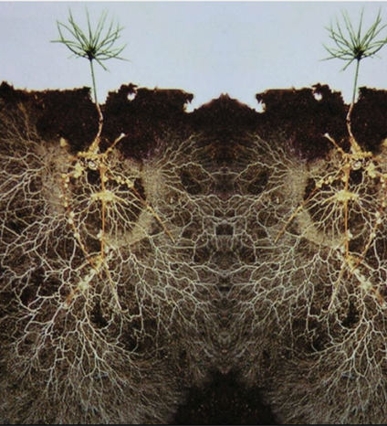
What else do plants talk about?
Undergraduate Dissertation Presentation ​
Biological & Environmental Sciences ​
University of Stirling​
1

Slide 2




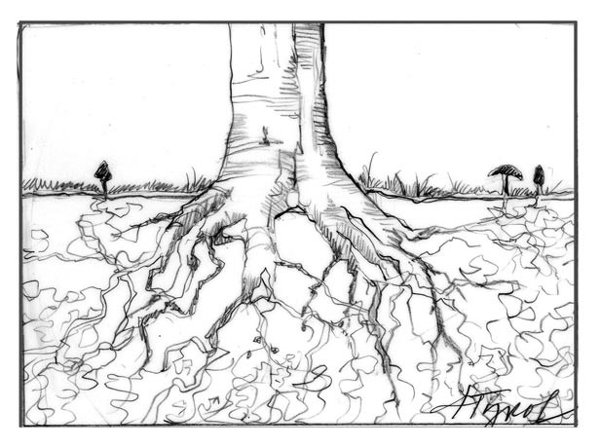
Project background
Undergraduate Honours Project
for Biology degree
Supervised by Professor Alistair Jump
Industrial partnership with Mycorrhizal systems Ltd.
& Working with founder Dr Paul Thomas
Aim
Investigate novel lines of plant communication and the role of mycorrhizae in this interaction
2

Slide 3
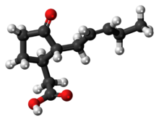
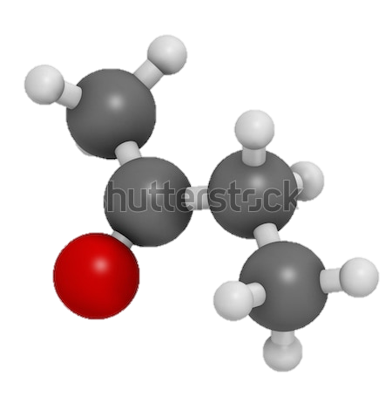


Contents
Why is understanding plant communication important?
What do plants talk about and how?
New lines of communication
Experimental
findings
3

Slide 4
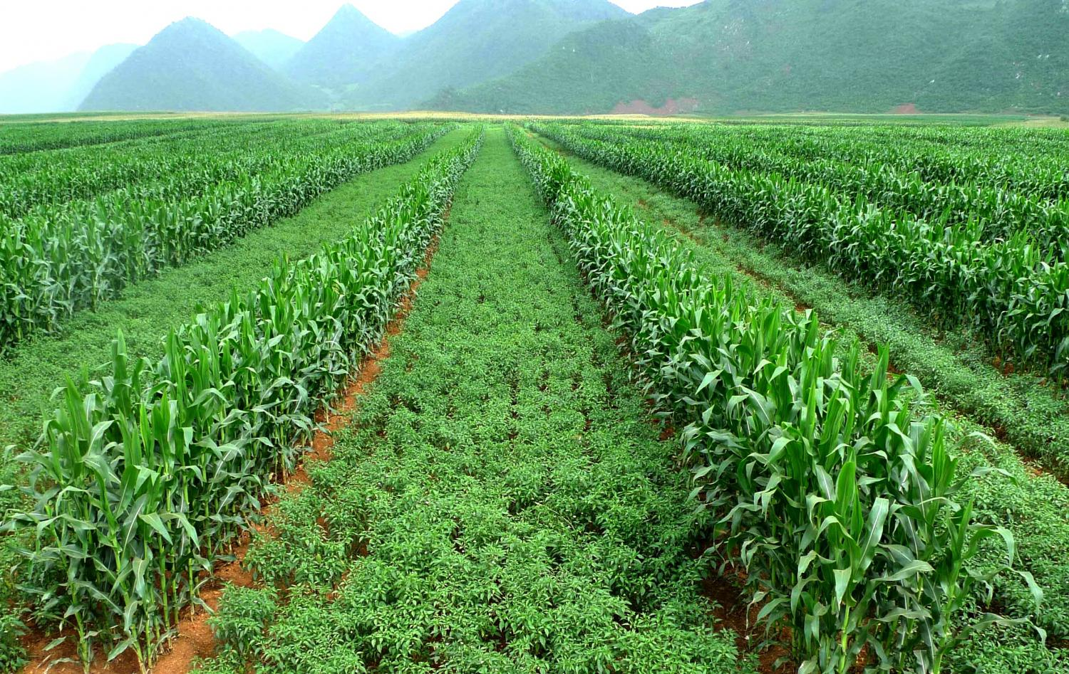
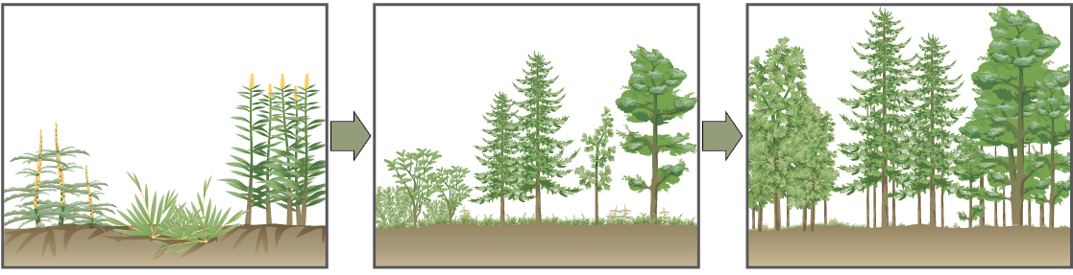
Why is it important to understand plant interactions?
Agriculture
Intercropping (Ashraf et al., 2017)
Allelochemicals (negative effects, germination, crop productivity)
Crop modelling (Yield prediction and process optimisation)
Forestry
Plant succession affected by allelochemicals (Koocheki et al., 2012)
Keeping some mature old growth trees ‘mother trees’ which aid the recruitment of new saplings
4

Slide 5
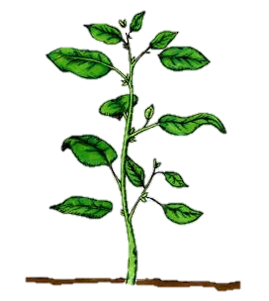
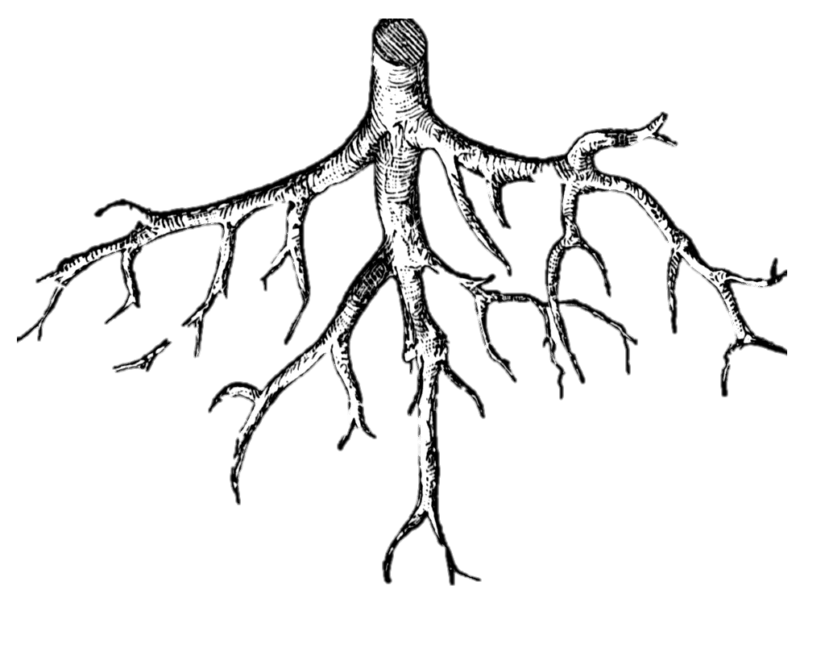
What do plants talk about and how?
1
1 – Defence signalling can occur through volatile organic compound transfer (Song & Ryu 2013)
2 – Resource and stress signalling can occur through root exudate transfer (Williams & Vries 2018)
3 – Root exudates can be passed via mycorrhiza that connect multiple plants (Barto et al., 2011)
2
3
5
Sender Individual
Receiver Individual

Slide 6
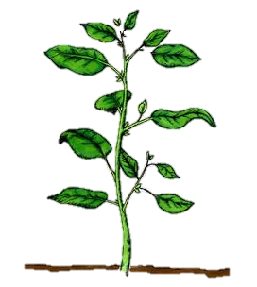

Within plant irradiance signalling
Irradiance good contender;
Already within plant signalling to allow developing tissue to optimise
(Thomas et al., 2003; Thyroff et al., 2019)
Unknown signal
May be passed to root and between plants
6

Slide 7
Within plant irradiance signalling
Irradiance good contender;
Already within plant signalling to allow developing tissue to optimise
(Thomas et al., 2003; Thyroff et al., 2019)
Unknown signal
May be passed to root and between plants
7

Slide 8
Research question:
Do plants communicate about irradiance and what is the role of mycorrhizal fungi in this interaction?
8

Slide 9
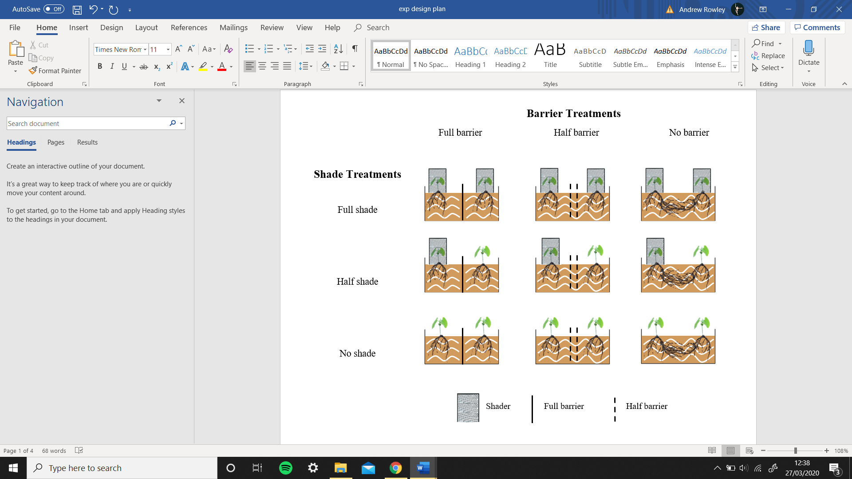
Experimental design
Tomato plants
Mycorrhizal fungi (AMF) (Rhizophagus intraradaces)
Three shade crossed with 3 barrier treatments
9

Slide 10
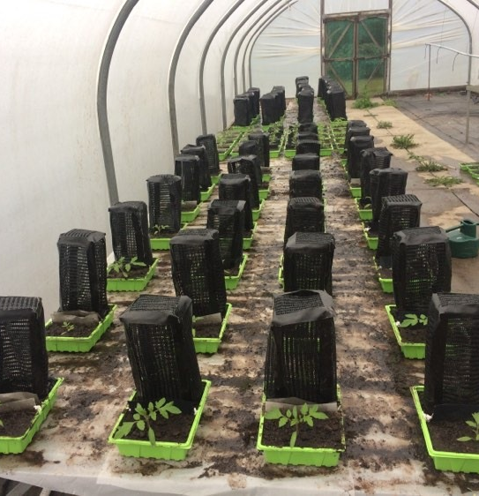
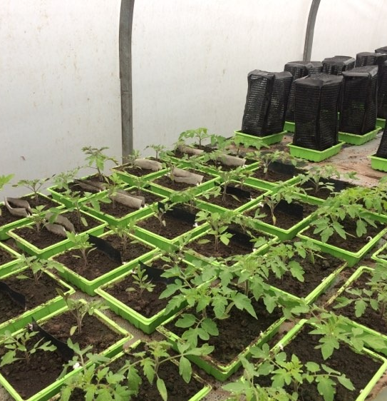
10

Slide 11
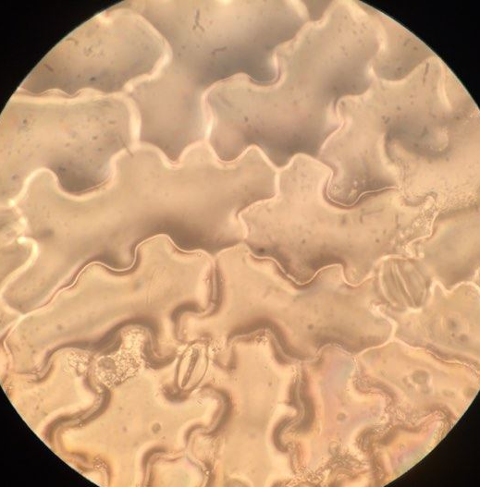
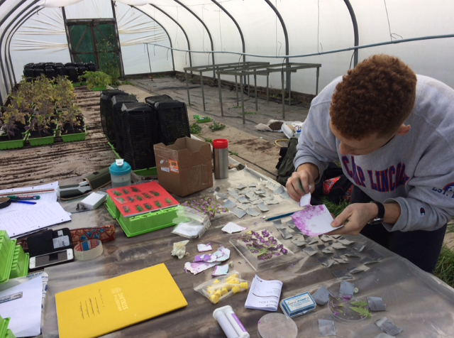
Data collection
Stomatal density of leaves
Plant height
Chlorophyll content of leaves
11

Slide 12
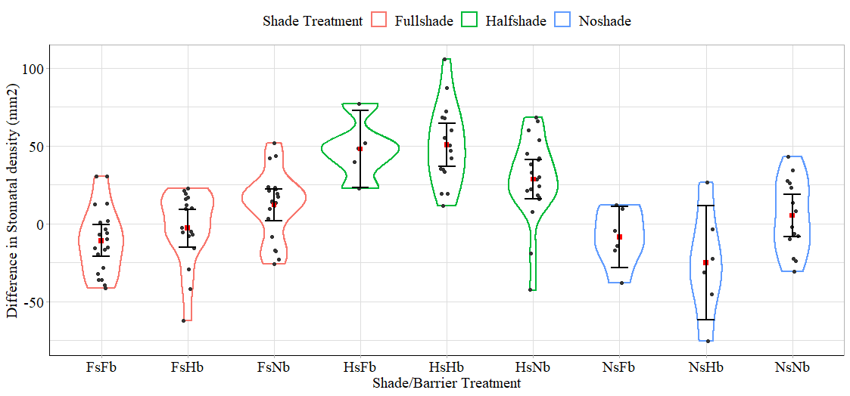
12

Slide 13
13

Slide 14
Plants with no barrier have;
Increased root space
(Kharkina et al., 2002)
Access to more nutrients
(Hu & Schmidhalter 2005)
Competition
(Copenhaver-Parry & Cannon 2016)
14

Slide 15
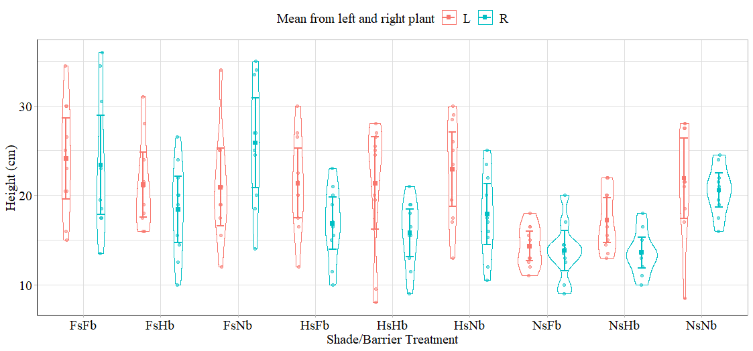
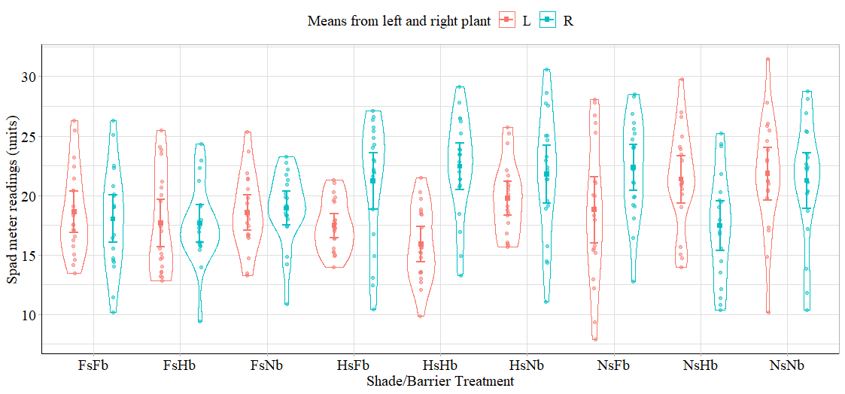
Other results
Plant height
This was result was mirrored in plant height
Leaf chlorophyll content
Contrastingly, leaf chlorophyll content did not show the effects

Slide 16
So do plants communicate over irradiance?
This study finds no evidence for plant communication over irradiance
However,
Differences between treatments may have overridden changes in growth caused by any communication
Cannot conclude there was no irradiance signalling as no test for any communication were made (Mycorrhization or Labelling experiment)
15

Slide 17

Conclusion.
Jury is still out over on irradiance signalling between plants
This is Bob, Bob keeps his treatments identical apart from the factors he’s testing. Bob is good, be like Bob.
For firm conclusions, about irradiance signalling, to made, verification tests needed.
Bob keeps his treatments identical apart from the factors he’s testing.
Bob is good.
16

Slide 18
Acknowledgments
Mycorrhizal systems for part funding
Dr Paul Thomas for his time and expertise
Professor Alistair Jump for his patience and lessons
Dr Luc Bussiere & Dr Brad Duthie for aid in statistical matters
17

